Slide 1

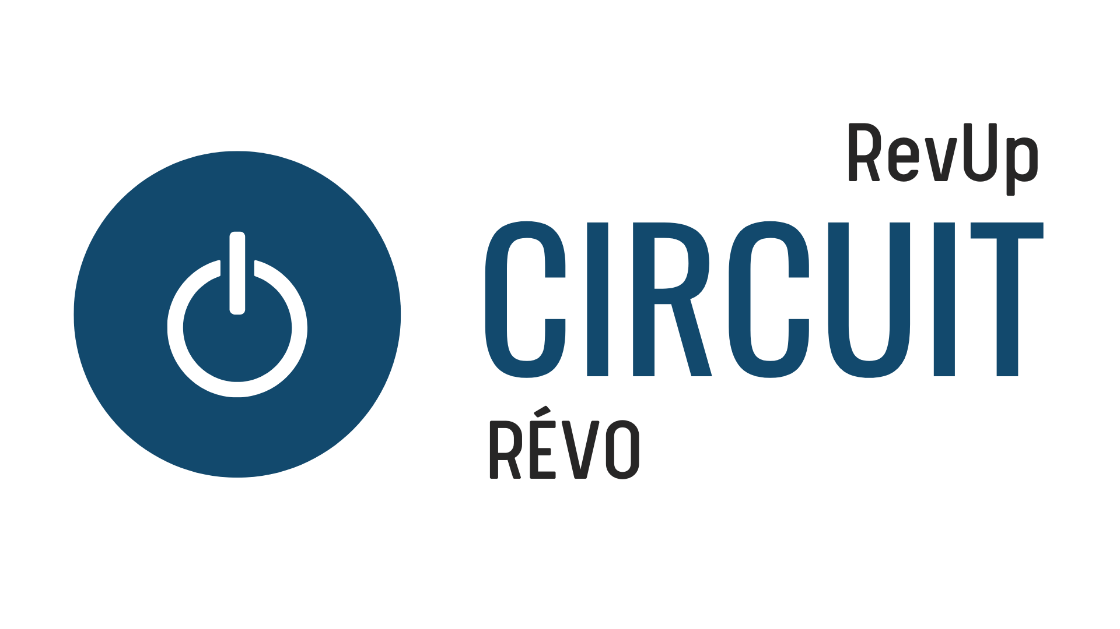

Business Model 101

Slide 2
Business Model: A business model describes the rationale of how an organization creates, delivers, and captures value.
Notes:
This first slide is an introduction to business model. This is to provide a common understanding of what a business model is.
The definition itself can be recited to the group.

Slide 3
What Does a Business Model Tell You?
The story of how your business will deliver value to its customers
A strategy on how your business will make money
Answers the questions:
  Is my business viable?
  Is my business feasible?
  Is my business desirable?
Notes:
Students should understand what a business model means and what it tells someone.
Emphasize that all businesses create value for their customers and the business model tells you how exactly that value is delivered.
The business model, fundamentally, answers the questions:
Is the business viable? – can the revenues outweigh the expenses
Is the business feasible? – can we tangibly deliver the value we say we can?
Is it desirable? – do people want what we are selling?

Slide 4
Business Model Canvas
Notes:
Now we are going to talk about the framework that helps companies map out their business model, called the business model canvas.

Slide 5
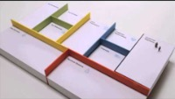
Notes:
We’ll start my watching a short video as a primer for the business model canvas.

Slide 6
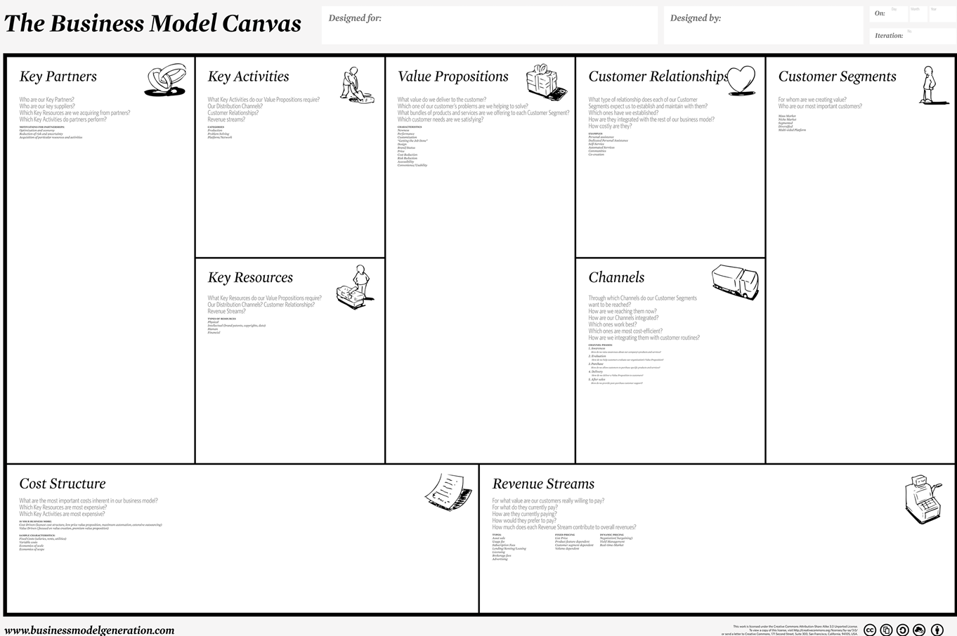
Notes:
This is our business model canvas tool, which maps out the nine building blocks we need to determine to understand the strategy for our business.

Slide 7
FEASIBILITY
DESIRABILITY
VIABILITY
Notes:
The business model canvas helps us answer three very important questions about our business. Without these three things, you will not be successful in operating your business.
The first thing *click* is understanding the desirability of your business. Do people want what you are selling?
The second thing *click* is understanding the feasibility of your business. Can you build what you are selling? Can you get the right people and resources together to deliver value to your customers?
The final thing *click* is understanding if your business is viable. Can your revenues outweigh your expenses?

Slide 8
OPERATIONS
MARKETING
FINANCE
Notes:
These three things translate into your business plan, when the time comes to write one.
Desirability turns into your marketing strategy.
Your feasibility turns into your operations strategy.
And your viability turns into the financial strategy.

Slide 9
The Business Model Canvas
How a business creates value
by delivering a product or service
Notes:
To recap, a business model canvas is a thinking tool, that we as entrepreneurs use to map out how our business will create value for customers, by delivering a product or service.
Let’s talk about each of the nine building blocks in more detail.

Slide 10
Customer Segment
Customers are the individuals or groups that need the value you are providing.
Who are they and why would they buy?
Notes:
First, let’s talk about the customer segments. These are individuals, groups or other companies who need the value you are providing.
With your customer segments, you want to understand who they are and why they would buy from you. What job does a customer need done, which you can provide a product or service to support?

Slide 11
Customer Segments
Startups can have multiple customer segments
  Paying customers are people or businesses that make the payment for the product
  Users are people that do not pay for the product but use it
  EX – a child’s toy, the parent is the payer and the child is the user
For every customer segment, there needs to be a:
  Value proposition
  Revenue stream
  And whatever else may may be unique to that customer segment
Notes:
Understanding your customers is such a critical element of your business.
There are two types of customers that it is important to differentiate:
Paying customers, these are the people that actually pay for your offering
Users are people that are going to use it
In some instances, the payer and the user are the same, but there are other scenarios where the two are different.
For example – a child’s toy. The person paying for it is the parent, where the person using it is the child. Another example is a piece of corporate software. There is a person that makes the decision and pays, and then there are the employees that use it.
Within your business model, you need to consider each as a distinct customer segment. The value may be different of the payer than the user, and it is important to account for both.
A parent, when seeking a child’s toy, wants it to be something safe for them to use, something they will enjoy, etc. While the child wants it to be fun! Balancing both of these customer segments and the value is critical to the success of your business.
For every customer segment you have, you need to make sure there is a value proposition and revenue stream associated with that customer segment. There also may be other unique components throughout the business model affiliated with your customer segment, like a key partner, or activity.

Slide 12
Value Proposition
The value proposition solves a need or a problem
What pain are you solving? What jobs are being done?
It is not:
About your idea
The exact product
Notes:
The value proposition is the next element of the business model canvas. The value proposition reflects a need your customer has, or a problem that they need solved. You can think about framing your value proposition as the pain you are solving, or the job it is doing on behalf of your customers.
The value proposition should not articulate your idea or the exact product, it focuses on the problems and needs of your customer.

Slide 13
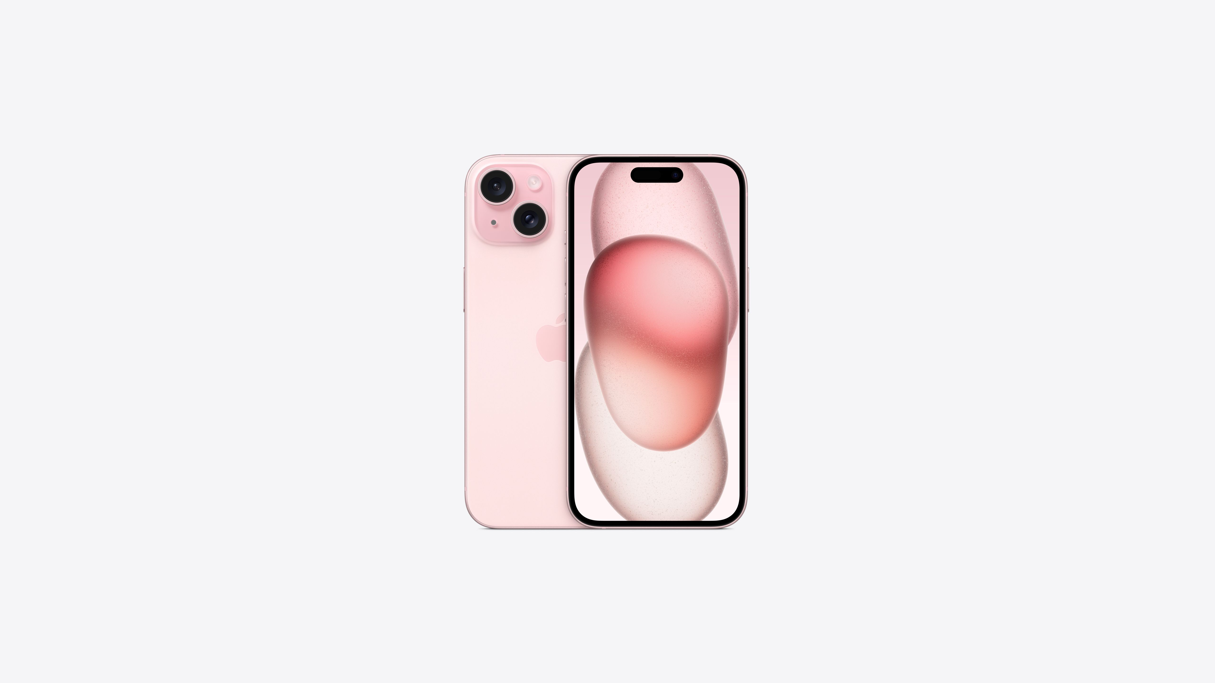
Understanding Your Value Proposition
Value Propositions
Features
Help a person do their tasks faster (email, social media, etc)
Keep you connected (people, news, etc)
Customize the colour
Decide what apps you want to prioritize and have on your phone
Be associated with the brand
Links with all of your other Apple devices
Super retina XDR Display
Made from titanium
Pro camera system
10x optical zoom range
29 hours of video playback
USB-C charger
Notes:
Using the iPhone as an example, let’s walk through the value propositions VS features of the iPhone.
The value propositions are what you want to focus on within your business model canvas. No one is purchasing an iPhone strictly for the USB-C charger or the super retina display. They are purchasing it for the value it provides, such as the fact it helps keep you connected, gt things done, allow you to connect with a certain social class, etc.

Slide 14
Product Market Fit
When the value proposition aligns with the needs of the customer segments, that is when you have product market fit.
How do you know if you have product market fit?
If you asked all customer segments how disappointed would you be if the startup shut down?, the answer should be very disappointed.
If they would not be disappointed, you do not have product market fit.
Notes:
When you can algin your value proposition with your customer segments, this is when you achieve what’s called product market fit. There are many ways you can look at product market fit, and it goes through stages based on how far advanced you are with your product, but you want your customers to be very disappointed if your product was no longer able to solve the problem they have. If they wouldn’t be disappointed to no longer have your product, then you likely do not have product market fit.
If your value is not aligned with your customer, you need to either look at:
Changing the customers, you aren’t solving the right problem for the right group
Change the value proposition, it is the right problem, but how you position that problem does not resonate with your customer

Slide 15
Channels
Channels are how you deliver your value to your customer segments.
A startup can have:
Physical channels: storefronts, markets, etc
Digital channels: online store, etc
Notes:
The next building block we are going to discuss is Channels. Channels are how you physically deliver value to your customer segments.
As an entrepreneur, you can have both physical and digital channels. Physical channels are things like markets, while digital channels are online stores.

Slide 16
Channels
How to communicate and reach customers
Different types of channels:
  Communication – building awareness
  Distribution – getting the product to the customer
  Sales – making the transaction
Channels represent your touchpoints with customers
Notes:
Channels represent how you communicate with the customer across all stages of the purchasing decision.
You can have different types of channels
Communication channels, which help you build awareness with your customers
Distribution channels, how you get the product to your customer
Sales channels, how someone makes the purchase for your product
These channels represent the touchpoints with your customers and key partners

Slide 17
5 key touchpoints with customers
Awareness | Evaluation | Purchase | Delivery | After Sales
Tactics to build awareness of your product.
Tactics to help customers decide to purchase.
Tactics used so a customer can make a purchase of your product.
Tactics to get your product into your customer’s hands.
Tactics to help customers after their purchase.
Notes:
These are the five key touchpoints that an entrepreneur has with their customer.
First is awareness. People need to know that you are around and in business, in order to consider your product or service.
Second, is evaluation. A customer goes through a process (some products are short processes, while others are longer processes) to decide whether or not they want to make a purchase. This is called Evaluation. You, as a business owner, will deploy certain tactics to help people make that decision. It will look different for every business – for some it’s sending them a discount code, or speaking with someone, putting out marketing material, etc.
Next is the purchase. How are they going to make the purchase?
After that is delivery. How can they pick up the product? Is it delivered to them, do they pick it up, is it a digital product that goes to email?
Lastly, is the after sales. How are you there to support your customer after they’ve purchased the product? For some it’s a how to guide on how to set it up, and fairly low touch, but for others there may be a more comprehensive follow up.

Slide 18
Customer Relationships
Customer relationships describes the types of relationships a company establishes with specific customer segments.
Customer relationships are how you get, keep and grow your customer segments.
Notes:
Customer relationships are the strategies that you as an entrepreneur will use to get and grow your customer base.

Slide 19
Customer Relationships
Create Demand | Gain Customers | Keep Customers | Grow Customers
How will potential customers know about you? | How do you get them to make a purchase? | How do you keep customers engaged with your company? | How do you utilize your current customer base to grow your company?
Notes:
First, you want to create demand for your product / service. What strategies will you use to create that demand for what you are doing?
Gain csutomers, means the strategies you will use to get customers to make a purchase.
Keeping customers are the strategies you will use to keep them loyal and interacting with your company. Newsletters, referral codes, discount codes, etc.
Lastly, growing your customer base will take strategies to leverage your customer base to offer them additional products, or get their referrals, etc.

Slide 20
Revenue Streams
Revenue streams are how the startup is going to make money!
What is your customer paying for? What type of pricing model does the startup have?
Notes:
Revenue streams, quite simply, are how you make money with your startup. What is it that your customers are paying for, and what’s the pricing model you will use?

Slide 21
Revenue Streams
Examples of revenue models:
  Sale of a product, direct to consumer through physical or digital means
  Subscription service (flat rate, tiered)
  Advertising opportunity, ad revenue
  Razor and blade model
Special considerations:
  All customer segments need a revenue stream
    Some customer segments could share a revenue stream, but have different value propositions for making the purchase
  Not all customer segments will make you money
    In the catering example, no revenue made from the people eating the food for the startup, so those would be considered a “free” segment
Notes:
Review the key revenue models with the group.
There are a few special considerations when looking at the revenue for each customer segment. First, all customer segments need to have a stated revenue stream. In some instances, you may not make money off of each customer segment. If we go back to the children’s toy example, one of our customer segments is a child. We don’t make money from the child using the toy, we make money off of the parent purchasing it. Therefore, the revenue stream is considered “free”. Another example would be with a catering company. A catering company sells its services to a business. The business then serves the food at an event and people eat it. The company doesn’t make any money from the people eating the food (who are a customer segment, considered a user). So they are considered a “free” revenue stream”.

Slide 22
Example 1: Barbie
Product / Service | Pricing
Barbie | Sale of product - $30-$40
Barbie Clothes | Sale of product - $10
Barbie House | Sale of product - $60
Barbie App | $3.99 / month
Notes:
Here is one example of how we can lay out our revenue streams. This is for a physical product that someone purchases.

Slide 23
Example 2: Coaching for University Students
Product / Service | Pricing
1-1 Coaching | $25 / hour
Coaching Bundle | $100 for 5 hours
Resume Review | $50
Administer & Review Career Aptitude Test | $100
Notes:
Here is another example of a service based business.

Slide 24
Key Resources
What are the most critical resources or assets required for the startup to deliver value to its customers?
Financial resources? EX – loan, line of credit, grant
Physical resources? EX – equipment, vehicle, space
Intellectual resources? – patent, trademark
Human resources? EX – engineer, teacher, etc
Notes:
Key resources are the assets that you need for your business to deliver its value to customers.
There are four types of resources for you to consider.
Financial resources would be anything monetary resources you may need to get yourself started, like a loan or line of credit.
Physical resources are any assets that you would need to create or deliver value. Perhaps you need a specific type of equipment to build your product, you need a vehicle to transport things places, you need a physical space to sell.
Next are intellectual resources. Not every business will have intellectual resources. If there is a “secret sauce” to what you do, or an image or a saying that’s important to your business?
Lastly there are human resources. Do you need a specific type of talent or expertise on your team to deliver the value? If you are developing an app, do you need a developer?

Slide 25
Key Activities
What are the most critical activities required for the startup to deliver value to its customers?
Review each box in the business model and ask, what activities need to be performed?
Assume that day-to-day activities like bookkeeping, payroll, administration are accounted for.
Notes:
Next are key activities. This is where you list the most critical activities you need to perform to deliver value to your customers. Think about what’s unique to your business. Assume day to day tasks are taken care of, like administrative tasks. What you want to focus on are the activities that are you unique to your business. This could be things such as building the product, maintaining the product, going to tradeshows, keeping a website up to date, etc.

Slide 26
Key Partners
Who does the startup need to work or connect with to deliver value to its customers?
Does the startup need to work with a supplier?
Does the startup need a joint venture to work with a customer segment?
Does the startup need a certain resource?
Notes:
Key partnerships is the next building block. These are organizations that you work with to deliver value to your customers.
You could use partners to connect with potential customers.
You may need a supplier who will give you part of what you need to build your product.
You may rely on another organization to lend or give you a key resource, like a vehicle, space or equipment.
Key partners play an important part in your business model, to access key resources, perform key activities, execute customer relationships and channels, allowing for you to connect and deliver value to your customer.

Slide 27
Cost Structure
What are the critical expenses that the startup will have?
Go back through the business model and look at:
Customer relationships
Channels
Key activities
Key partners
Key resources
What items in these boxes are going to cost money?
Notes:
The last building block are the cost structures. This is where you summarize all of the critical costs associated with the business. Walk back through your canvas to understand what costs money. Is it a customer channel? A key activity? Do you need to pay for a resource?
What items are going to cost money.

Slide 28
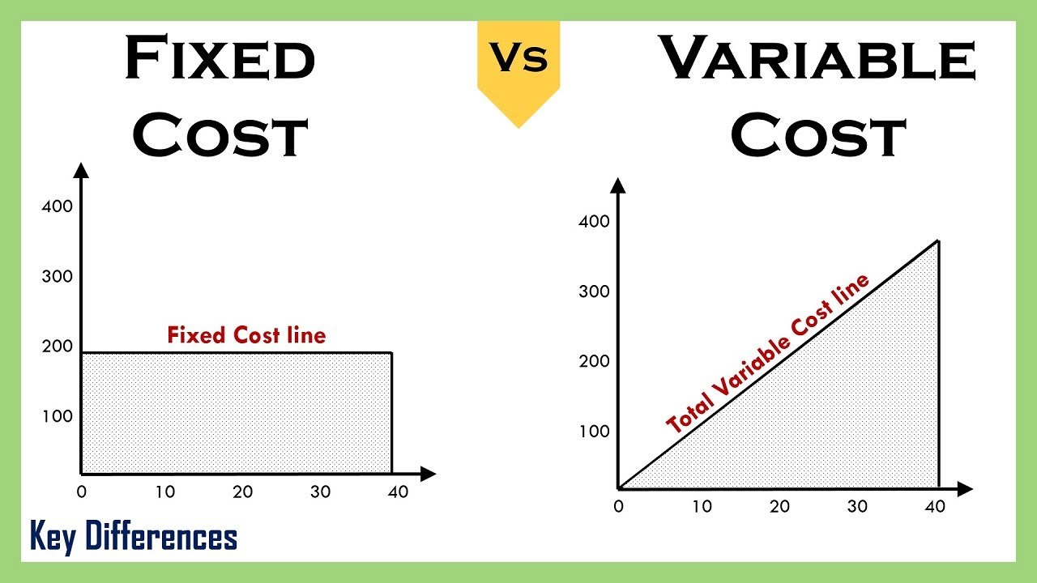
Types of Costs
Notes:
There are going to be fixed costs and variable costs with your business.
Fixed costs are costs that do not change no matter how many units you may produce or sell. Examples could be your domain, web hosting, rent, utilities, etc.
Variable costs, change based on how many units you produce or sell. Let’s say you are building a children’s toy and you need materials to build that toy. The amount of material you need changes if you are building 10 units VS 100 units. This would be considered a variable cost. Eventually, you want to achieve something called economies of scale. This means that the higher volume you purchase, the unit cost reduces. For example, materials to make 10 units could be $5 per toy. But when you build 100 units, materials goes down to $3 per toy.

Slide 29
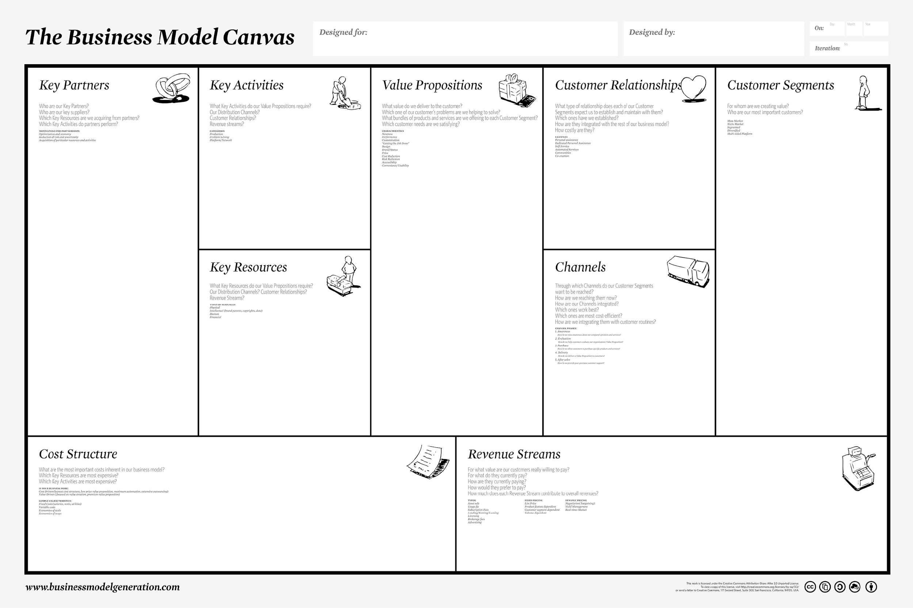
Guess
Guess
Guess
Guess
Guess
Guess
Guess
Guess
Guess
Notes:
After we have sketched out our business model, these are considered to be guesses for right now. We have made assumptions about the business. Your next step, as entrepreneurs, is to validate those assumptions with actual people that want to buy what you are selling, those that you can partner with, give you resources, etc.

