Slide 1
How To Create Value
Give your customers what they want

Slide 2
What do you do?

Slide 3
Myths & Misconceptions
The market is stranger than you think

Slide 4

You Can’t Sell To Everybody
No business has 100% market share
As a small business, you have a small potential market.
Who will you create value for?

Slide 5
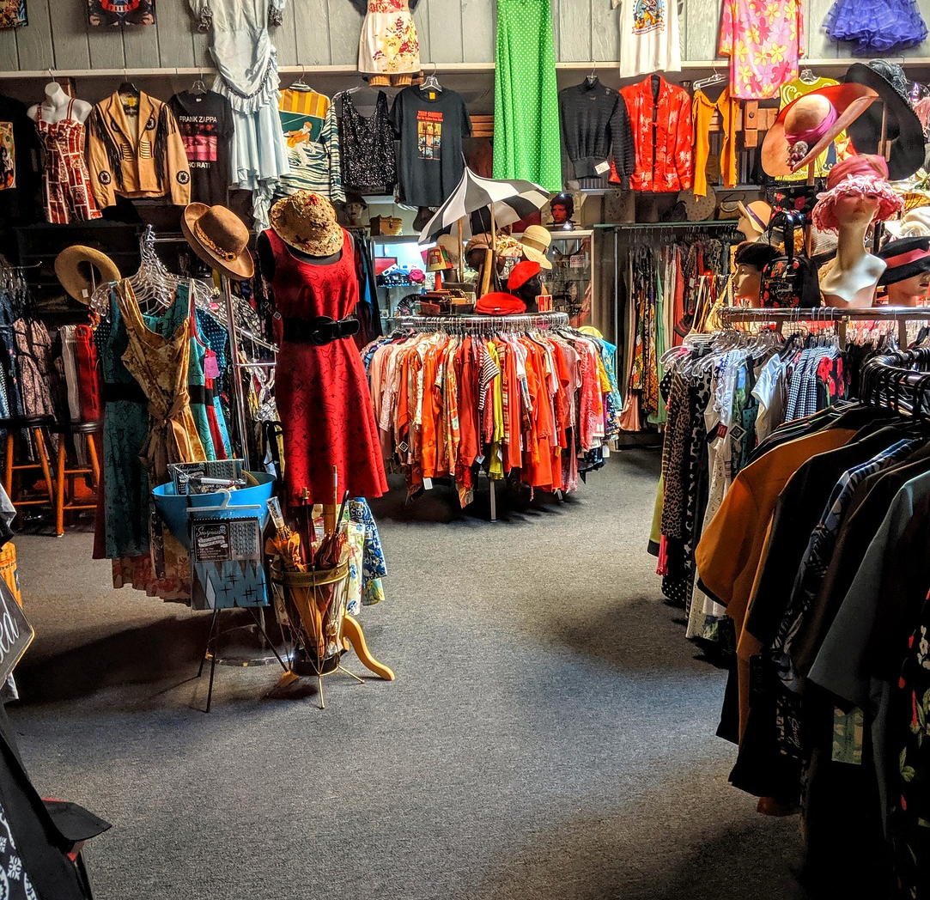
Nobody Cares What You Sell
We buy because of how the product/service makes us feel
We like to buy what we want, not what we need
We want our lives to be made better in some way

Slide 6
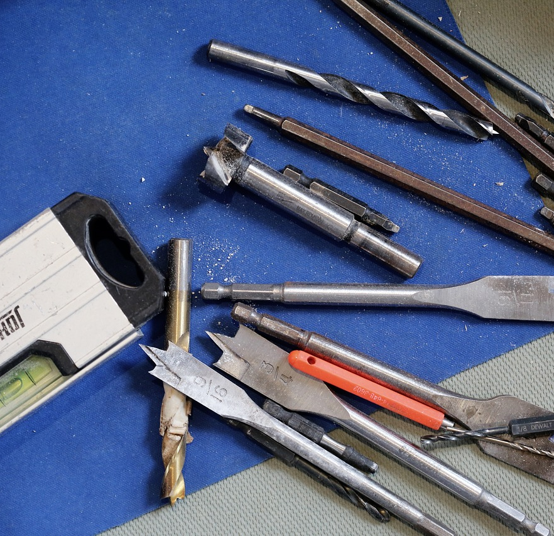
Nobody Wants a Drill Bit
Most purchases are a means to an end
Often your customers don’t even know what they really want.

Slide 7

Finding The “Why”
What does your customer really want?
Why don’t they already have it?
What is the underlying need?
  Keep asking “why”

Slide 8
Finding Value
Great solutions are FAB

Slide 9

Features (What?)
List what you offering includes, looks like, etc…
Colours
Size
New innovations
Example:
“The new C278 features the best weather sealing on the market”

Slide 10

Advantages (Why?)
What do the features you listed fix
For example:
“Our camera works in even the heaviest of rain”

Slide 11
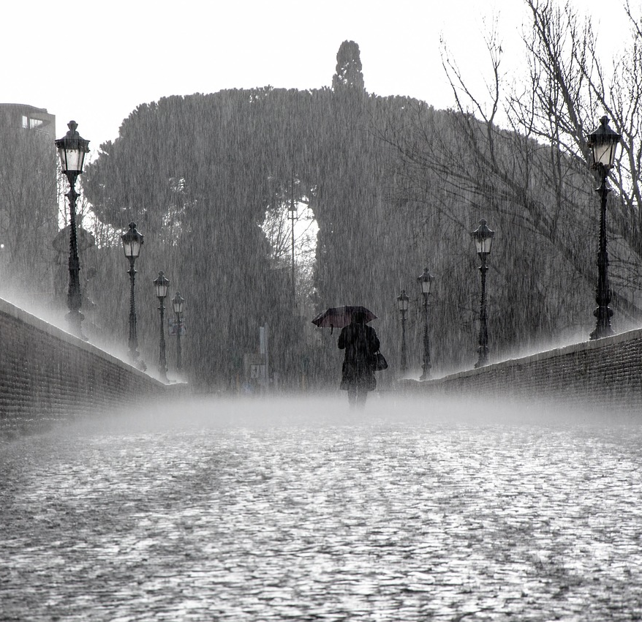
Benefits (How?)
How your customers benefit from your offering.
Example:
“Never miss a moment, no matter what Nature throws at you”

Slide 12
Product/Service Value Proposition
What IT Does

Slide 13
Begin With The Value
Feature
Advantage
Benefit
Simplified Menu
Local ingredients
Easier to navigate
Picked fresh
Support local farmers
Eliminates frustration
Tastes good and does good

Slide 14
Reframing
“We” focus
“You” focus
We’ve created what we believe is the best camera on the market. Our industry-leading quality control means that only the best product ever makes it to the customer. We know the C278 is good because we use it ourselves.
You love telling the best stories and you need something worthy of them. You don’t just need a camera; you need one that keeps up with everything you do. The C278 helps you capture moments your way.

Slide 15
Reframing
Feature focused
Value focused
The new C278 camera features a first-of-its kind total weather sealing system. Thanks to the IP68 rating for dust and water, your device can handle immersion in up to 6 meters of water for more than 40 minutes.
With the new C278 digital camera, you’ll never miss a moment again. Capture incredible memories even in the most extreme weather.

Slide 16
Company Value Proposition
What YOU Do

Slide 17
Bring in Your Values
Rational
Emotional
Providing excellence in education to adult learners
Turning hopes and dreams into lifelong success.

Slide 18
A Basic Formula
We help (customer) do (goal) by (solution)
At Innovation & Entrepreneurship, we help learners turn wild ideas into awesome things by giving them access to tools, resources, and guidance.

Slide 19
What do you do?

Slide 20
Questions?
Ready to get started?
gagnes1@algonquincollege.com

