Slide 1
Plan, model and opportunity
Three Approaches to the Challenge of Starting a Business.
Business Plan: Composed of sections that systematically outline concerns.
Business Model: A minimalist network of concerns across functions that distinguish the business.
Opportunity Pursuit: Focuses exclusively on business activity, prioritizing observe-decide-act processes over administration.

Slide 2
Business Model vs. Business Plan
Business Model: Highlights company features related to its value proposition, focuses on discovery and core mechanisms.
Business Plan: Systematic, outlines concerns in a standardized order, based on market knowledge and strategic objectives, especially financial.

Slide 3
Identifying Opportunity
Opportunities are favorable circumstances for forming a need for a new product or service.
Approaches analyzing opportunity aim to identify innovative potential generated by a situation: Valeur économique potentielle par un marché inexploité
Untapped market economic potential
Undeveloped resources
Unrecognized community ties and market support
Needs created by social systems (legal, cultural, moral)
A business opportunity must be:
Attractive and timely
Durable or sustainable
Offering added value

Slide 4
Appliquer l’outil Timmons
Timmons Model
Opportunity: Is there a clear need? Is the timing right, and is the market ready?
Entrepreneur: Does the entrepreneur have experience or credibility in the field?
Resources: Are capital, technology, materials, and personnel available?
Incertainty
Opportunity
Entrepreneur
Planification d’affaires autour des adaptations et des lacunes (fits and gaps)
Incertainty
Incertainty
Resources

Slide 5
Detailing Business Steps
The ways to detail the stages of the company are not contradictory:
Business Plan: Comprehensive, systematic, rich in quantitative data.
IpOp Model: Answers why and how of the product.
Canvas Model: Highlights important/unique aspects around the value proposition.
Lean Model: Concrete, quick customer-focused validation.
SynOpp Approach: Introduces continuous renewal measures.
Some of these paths focus on the product, others on the company.

Slide 6
Cheminer dans l’entrepreneuriat.
Type | Goal | Approach | Causality | Pathway | Effect on the Business
Planning | Establish strategies | Complete capture | Linear | Business plan | Imposes direction
Networking | Expand possibilities | Directed attention | Complex (Emergent) | Business Canvas | Build organization
Assembly | Solve poorly defined problems | Impulse towards movement | Chaotic | SynOpp | Gather disparate elements

Slide 7
The Cycle of Enterprise Growth
The assembly, networking, and planning approaches have distinct goals as milestones in a continuous cycle.
Assembly
Networking
Planning
Gather disparate elements.
Build the organization.
Imposed direction.

Slide 8
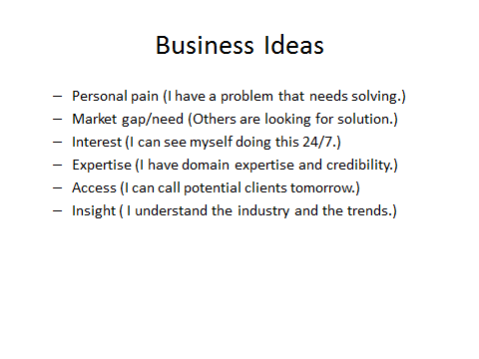
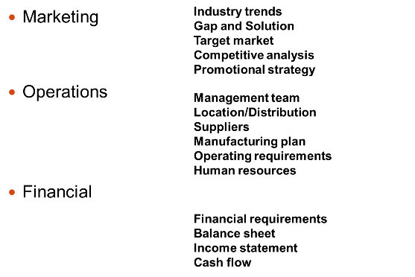
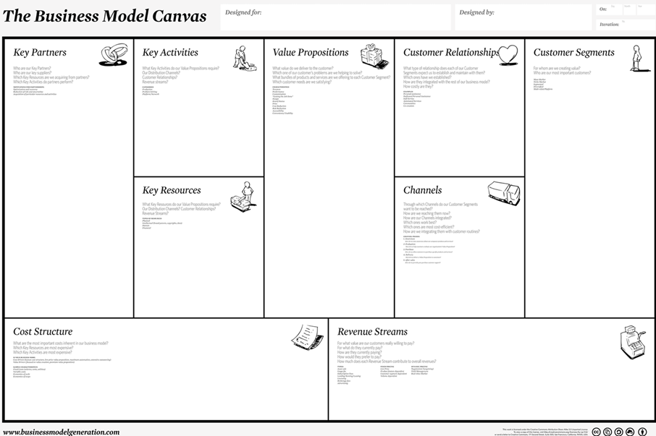
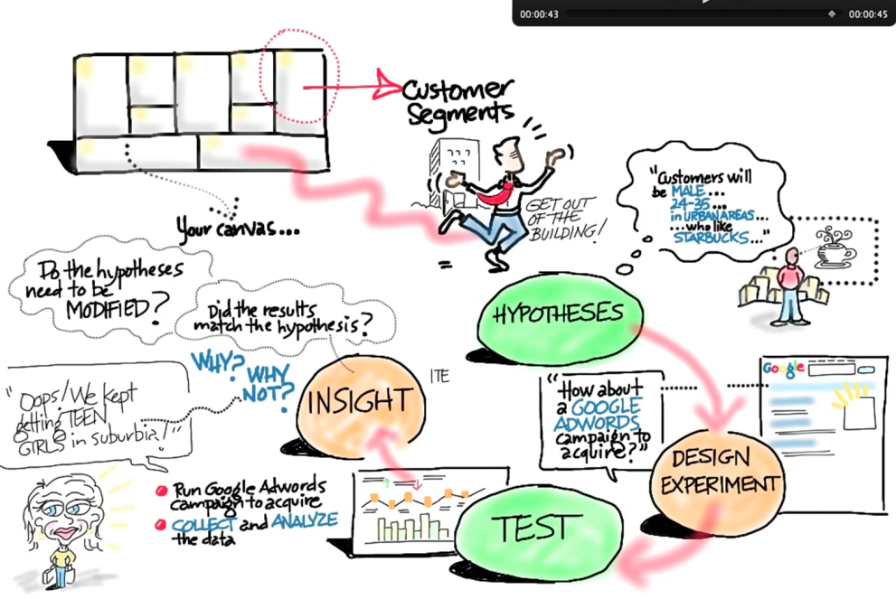
Le cycle

