Slide 1
Design Thinking
Innovation with Purpose

Slide 2
What We’ll Cover
  Why Use Design Thinking?
  The Design Thinking Model
  Iterative Design

Slide 3
Why Use Design Thinking?
A study in human-centred design

Slide 4

The Air Jordan Legacy
Michael Jordan wanted to end his deal with Nike
Tinker Hatfield was given the task of designing the shoe to keep the contract
He didn’t know anything about Air Jordans and hadn’t even met Michael Jordan
DOD photo by D. Myles Cullen, Public domain, via Wikimedia Commons

Slide 5
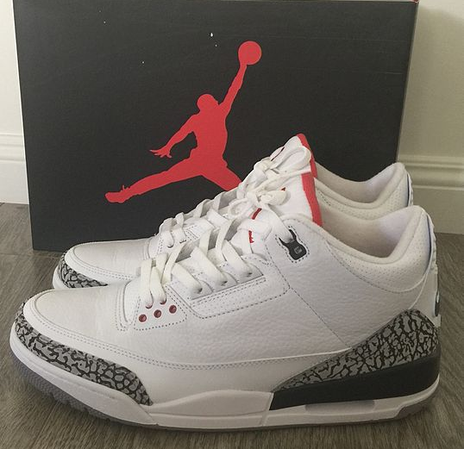
Saving Nike
Hatfield found out what Jordan did off the court
He met with Jordan to find out what he wanted in a shoe
Unlike any previous Nike designer, he put Jordan’s wants and needs first
2Pacalyp, CC BY-SA 4.0 https://creativecommons.org/licenses/by-sa/4.0
via Wikimedia Commons

Slide 6
Why it worked
Previous designs were entirely product-centred
Nobody had ever listened to what the players said they wanted
Hatfield empathized with his end user.

Slide 7
The Design Thinking Model

Slide 8
The Model
Empathise
Define
Ideate
Prototype
Test

Slide 9
Empathise
Who is this for?
What do they want?
Why doesn’t what is available now work for them?
Have you actually spoken with them?

Slide 10
Define
What is the real need?
How might you solve the need?
What resources do you have on hand?
How long can this take?
How much can you afford to spend?
How will you know if it is working?

Slide 11
Ideate
Based on what you know, what can you do?
Come up with as many solutions as possible
Don’t eliminate any ideas yet. The best ideas are usually close to the crazy ones.
What are your success indicators?

Slide 12
Prototype
Look at all of your ideas and pick one to test
The perfect prototype is:
  Easy to build
  Easy to test
  Shows results
Create a limited feature set offering (MVP)

Slide 13
Test
Get your prototype in front of people
Watch them use it
Get their feedback
Don’t take anything personally. Criticism of your prototype is not an attack on you.
If it works, keep doing it.

Slide 14
How it Usually Goes
Empathise
Define
Ideate
Prototype
Test

Slide 15
Implementing
The Final Phase?
Very few products stay the same for more than a few years.
Once you’ve solved one need more will appear.

Slide 16
Iterative Design
Making it happen in small steps

Slide 17
The Iterative Design Cycle
Ideate
Create
Test

Slide 18
Creating in Phases
Always have something you can test
Keep testing while developing
Keep improving

Slide 19
Activity
Uncovering the problem

Slide 20
Step 1
Ideate
In 15 minutes:
  Fill the sheet with possible problems
  Don’t erase any ideas
  Edit them later

Slide 21
Step 2
Compare
Compare your lists
Discuss your problem statements
Pick a big problem

Slide 22
Step 3
Critique
Dig deeper – 5 fold why
If this isn’t the real problem, what is?
Write your problem statement in 1 sentence

